Slide 1
Method Trace Analyser
Submitted by:
Team Name: The Debuggers
Team Members: Shefali Goyal [Team Leader]
Shriyansh Sharma
Saumya Singh

Slide 2
Problem Statement:-
The challenge is aimed at developing an application to assist developers in debugging code. Method tracing is one of the commonly used post-mortem diagnostic methods to identify problems. It consists of timestamp of entry and exit points for each method invocation. They may also contain stack-trace for each invocation. Depending upon the time for which trace data is collected, the file-size for these traces can be huge. Parsing them manually is a time-consuming and error-prone task.

Slide 3
Problem Description:-
For post-mortem debugging, method trace is one of the reliable options. For example, in case of hang / performance related issues - The time taken for each method invocation becomes a key factor. Number of method invocations can be another clue. In case of functional issues – Change in code-flow / Stack-trace. Gathering and comparing these data is time-consuming and prone to human error. The challenge is to create an application to aid developers in debugging Java method trace files.
We have developed a Java based GUI application which can parse and compare multiple method trace files. The primary goals would be to,
Compare two trace files: one from failing and passing case each and find out the anomaly.
Parse one or more trace file and suggest anomalies - I.e. Flag methods which are not completing their execution / Taking longer to execute. This will be helpful in addressing hang and performance related problems.
Parse one or more trace files and create a tabular and graphical view for the number of times each method is invoked. Comparative view in case of multiple files.
Compare code-flow and stack trace for failing and passing case and find anomalies.

Slide 4
Instructions for button “run code 1” & showing trace files as well as graphical analysis:--
Methodtrace.java
Run
Graph.java
Click on Button
“Run Code 1”
Log2.java file
Log3.java
This Run a Factorial Code using recursion with smaller input
Minimize the window (Don’t close it)
This shows the graphical representation of code- includes “execution time, performance, error, exception, line of code”
Click on “open trace file” button
This shows the file chooser window
Enter the smaller input in popup window and click “OK”
Select the “execptions.log” trace file from browse menu:-C:\Users\Lenovo\eclipse\java-photon-2\eclipse\ibm\src\ibm\execptions.log
This show the contents of trace file in text field area

Slide 5
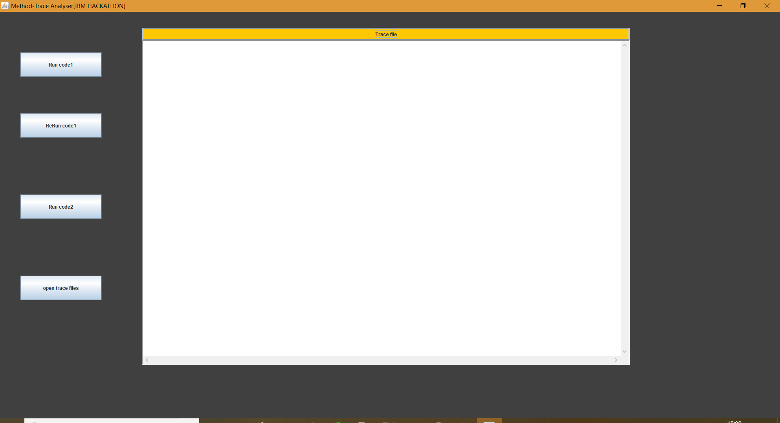
GUI Application:-

Slide 6
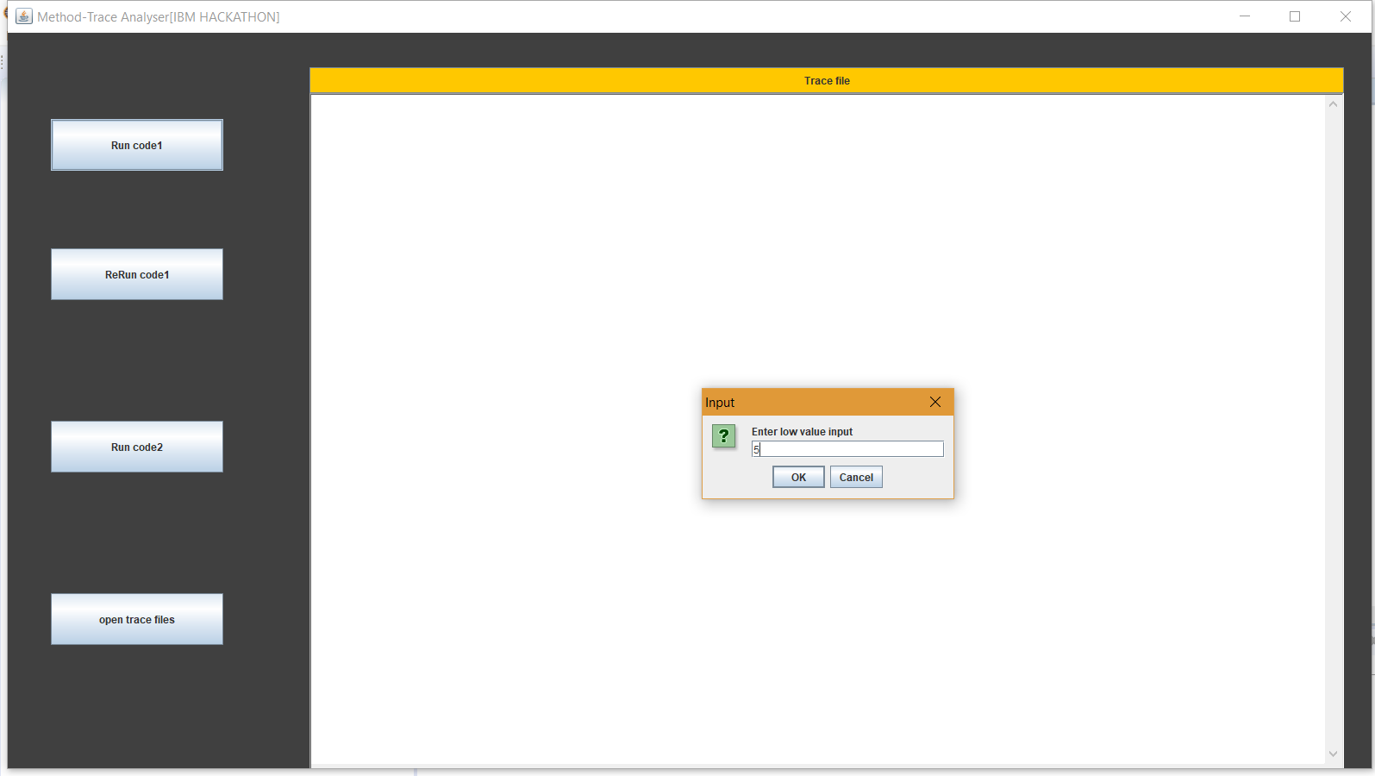
Input window using JOptionPane of java Swing:-

Slide 7
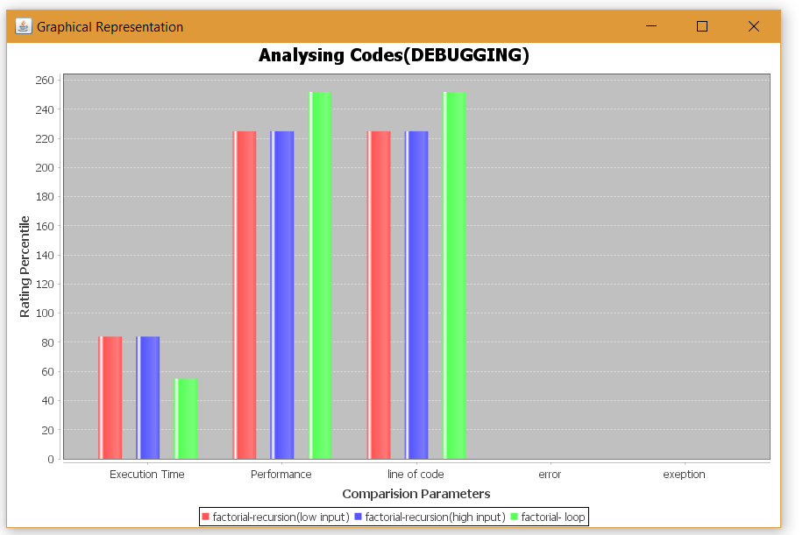
Graphical Representation on analysis of code, showing:--performance of the code, the line of code, execution time, errors and exceptions if any.

Slide 8
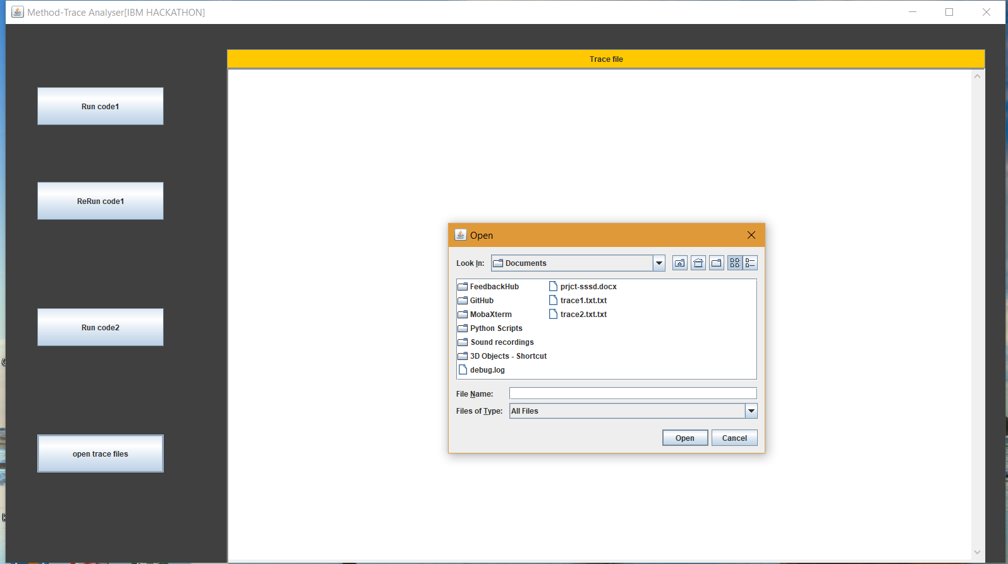
Browsing window- selecting trace file ”execptions.log”:-

Slide 9
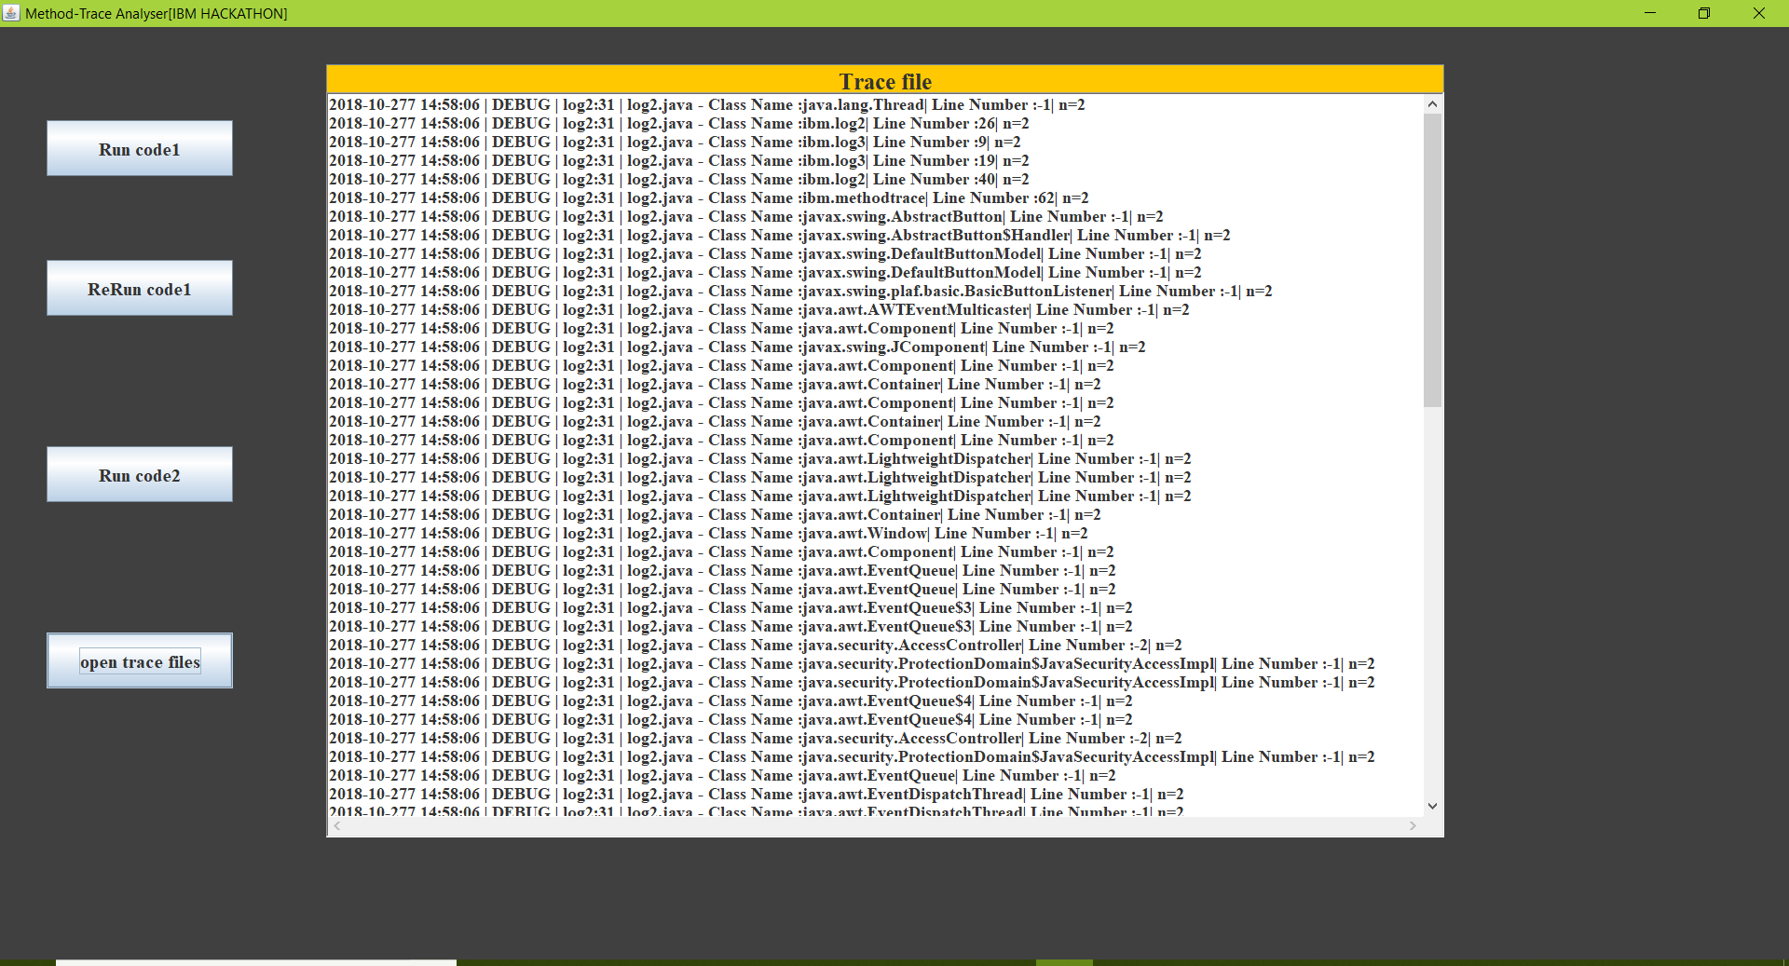
Trace file :analysis of code showing:-- Date, Time, Line Number, Class/Method Name, the output at each input in code, exceptions and errors if any, total execution time:-

Slide 10
Instructions for button ”rerun code 1” &showing trace file as well as graphical analysis:--
Click on Button
“Rerun Code 1”
Graph.java
Log2.java file
Log3.java
This Run a Factorial Code using recursion with input creating exception
This shows the graphical representation of code- includes “execution time, performance, error, exception, line of code”
Click on “open trace file” ibutton
This shows the file chooser window
Enter the input in popup window and click “OK”
Select the “execptions.log” trace file from browse menu:-C:\Users\Lenovo\eclipse\java-photon-2\eclipse\ibm\src\ibm\execptions.log
This show the contents of trace file in text field area

Slide 11
Instructions for button ”rerun code 2” &showing trace file as well as graphical analysis:--
Graph.java
Click on Button
“Run Code 2”
Main2.java file
Log4.java
This Run a Factorial Code using for loop
This shows the file chooser window
Select the “execptions.log” trace file from browse menu
This shows the graphical representation of code- includes “execution time, performance, error, exception, line of code”
Click on “open trace file” button
This show the contents of trace file in text field area

Slide 12
Project outcomes/results:-
The project will display a GUI application for method tracing.
The project will surely be helpful in saving a lot of time in analyzing and debugging a code. It will give us a graphical representation which will be the proof of analyzed code and will show us the performance of the code, the line of code, execution time, errors and exceptions if any.
While execution of the code trace file will be generated itself showing: Date, Time, Line Number, Class/Method Name, the output at each input in code, exceptions and errors if any, total execution time.

Slide 13
Advantages:-- This application is used to assist developer in debugging code and reduce the analysis time. Method tracing is most commonly used method to identify problems (post mortem debugging).
Graphical representation:
The Graph thus generated will be the proof of the analysed code and will show us
Performance of the code
Line of Code
Execution Time
Error or not
Exception or not
Trace file:
While execution of code, trace file will be generated by itself showing:- Date, Time, line number, class/method name, the output at each input in code(eg:- in loop etc), and the exceptions /errors occur if any, total execution time.

Slide 14
Technical details:- Language:- Java Framework:- Java AWT, Java Swing Libraries: Jfreechart, Jcommon, log4j IDE: Eclipse Photon
References:--
Internet
head first java book
THANK YOU

